Slide 1
Requirements Fundamentals
(Fall 2018)
Software Requirements Analysis
Week 2

Slide 2
Agenda for this Lecture
What are Requirements?
  Definition
  Levels and types of rqmts
  Their Importance
Role of Stakeholders
Introduction to Requirements Engineering
  Development
  Management
  Standards
Tools for RM
Discussion

Slide 3
Agenda for this Lecture
What are Requirements?
  Definition
  Levels and types of rqmts
  Their Importance
Role of Stakeholders
Introduction to Requirements Engineering
  Development
  Management
  Standards
Tools for RM
Discussion

Slide 4

Some interpretation of RQMTs
Project
requirements
Business Goal is …
Business rules
are ….
Features…
User story….
… requirements

Slide 5
About Requirements
“anything that drives design choices” (Lawrence 1997)
“a property that a product must have to provide value to a stakeholder”
“a specification of what should be implemented. They are descriptions of how the system should behave, or of a system property or attribute. They may be a constraint on the development process of the system” (Sommerville and Pete Sawyer 1997)

Slide 6
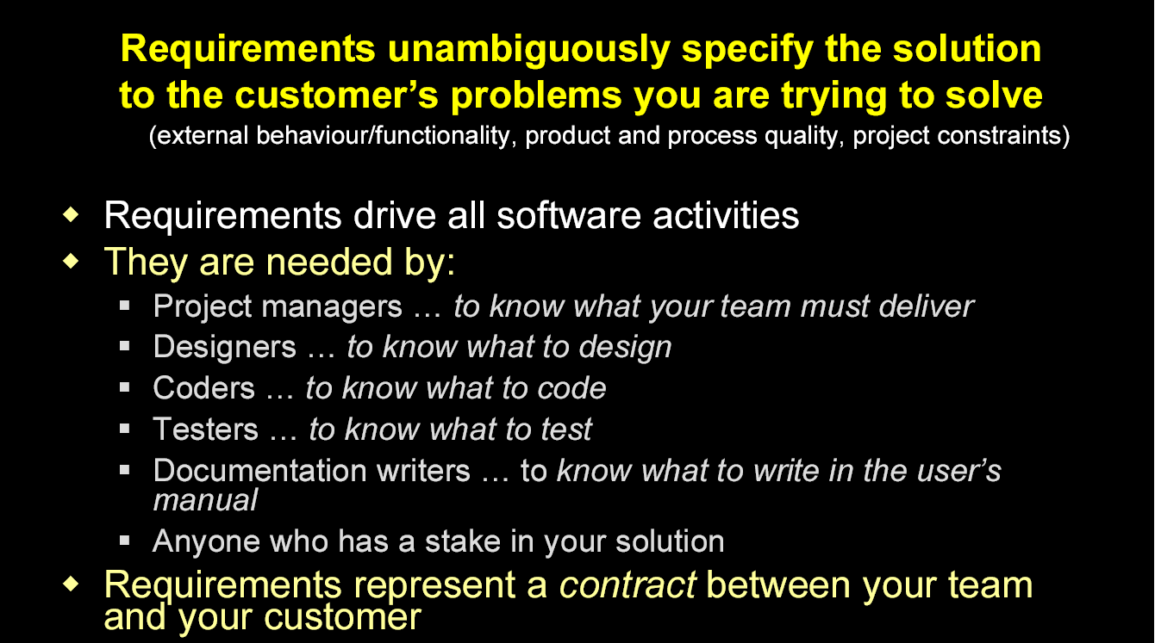
What are Requirements?
(extracted from the slides of Peter Hauker, Rational)

Slide 7
Levels and types of RQMTs
Business requirement
Business rule
Constraint
External interface requirement
Feature
Functional requirement
Nonfunctional requirement
Quality attribute
System requirement
User requirement
Relation

Slide 8
Levels and types of RQMTs
Business requirements: A high-level business objective of the organization that builds a product or of a customer who procures it
“an airline wants to reduce airport counter staff cost by 25%”
“we want to increase the profits by 10%”
“we want to improve the customer’s satisfaction”

Slide 9
Levels and types of RQMTs
Business rules: A policy, guideline, standard, or regulation that defines or constrains some aspect of the business
Not a software requirements in itself, but the origin of several types of software requirements
For example, with corporate security policies, business rules are the origin of specific quality attributes

Slide 10
Levels and types of RQMTs
Constraints: A restriction that is imposed on the choices available to the developer for the design and construction of product.
“Because of the legacy system, the DBMS must be ORACLE”

Slide 11
Levels and types of RQMTs
External interface requirements: A description of a connection between a software system and a user, another software system, or a hardware device.
“our system must interact with a camera”

Slide 12
Levels and types of RQMTs
Feature: one or more logically related system capabilities that provide value to a user and are described by a set of functional requirements.
ONLINE BOOKING system can provide “book a flight” and “book a room”

Slide 13
Levels and types of RQMTs
Functional requirements: specify the behaviors the product will exhibit under specific conditions.
They describe what the developers must implement to enable users to accomplish their tasks (user requirements), thereby satisfying the business requirements
“the passengers shall be able to print boarding passes for all flight segments for which he has checked in “

Slide 14
Levels and types of RQMTs
Nonfunctional requirements: a description of a property or characteristic that a system must exhibit or a constraint that it must respect
performance , security, “-libility”
external interface
design constraints

Slide 15
Levels and types of RQMTs
Quality attribute: a kind of nonfunctional requirements that describes a service or performance characteristic of a product
performance , security, “-libility”

Slide 16
Levels and types of RQMTs
System requirements: a top-level requirement for a product that contains multiple subsystems, which could be all software or software and hardware
cashier’s workstation in a supermarket

Slide 17
Levels and types of RQMTs
User requirements: A goal or task that specific classes of users must be able to perform with a system, or a desired product attribute.
“Check in for flight” using an airline’s website or a kiosk at the airport

Slide 18
The Relationship
Business RQMTs
Business rules
Vision and Scope Doc
Quality attributes
User RQMTs
User requirements Doc
External
interfaces
System RQMTs
Functional RQMTs
Constraints
Software Requirements Specification

Slide 19
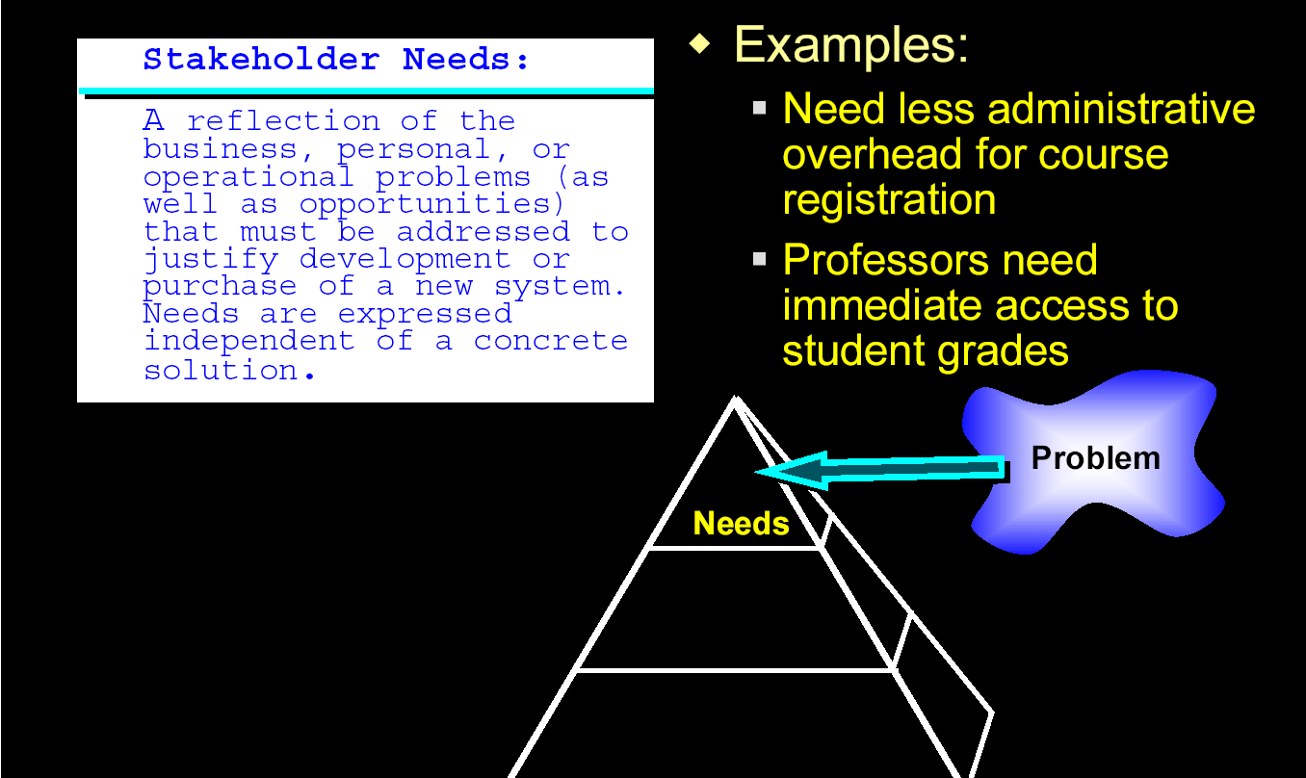
Stakeholder Needs
(extracted from the slides of Peter Hauker, Rational)

Slide 20
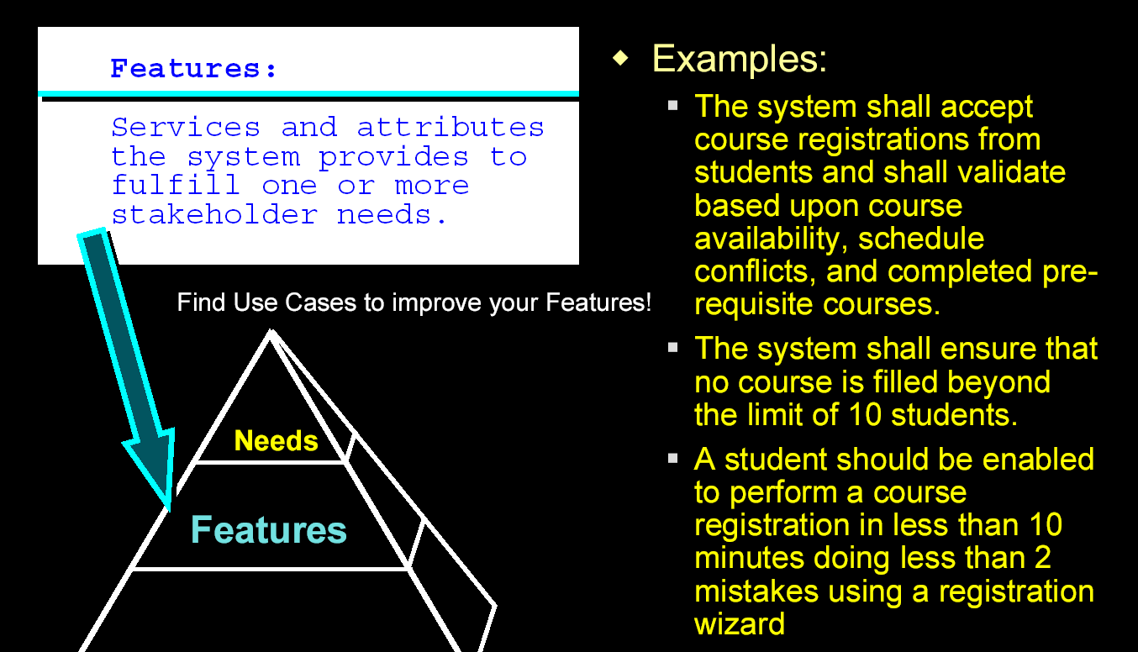
Features of the System
(extracted from the slides of Peter Hauker, Rational)

Slide 21
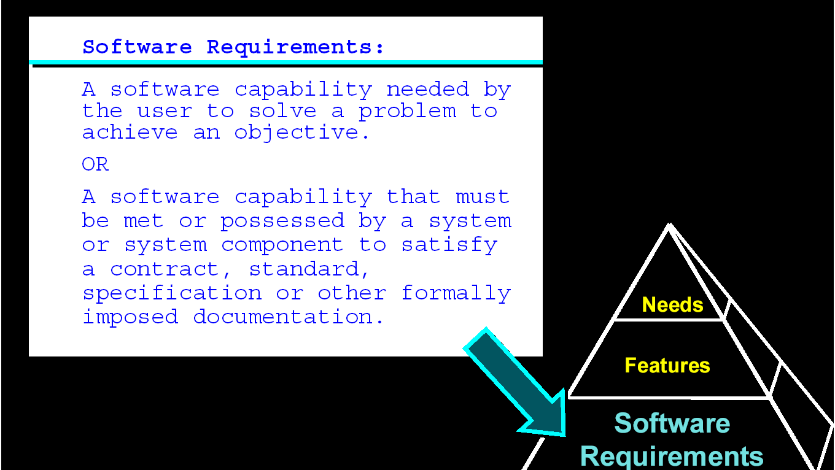
Software Requirements
(extracted from the slides of Peter Hauker, Rational)

Slide 22
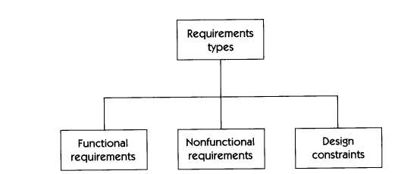
Requirements Types

Slide 23
Functional Requirements
Describe the functionality or services that the system is expected to provide
Address the input-output behavior of a system

Slide 24
Examples of Functional Requirements
3.1.1{FR1}
  Software shall automatically detect the presence of the network.
3.1.2{FR2}
  Software shall automatically detect the presence of other computers running the application that are connected to the network.

Slide 25
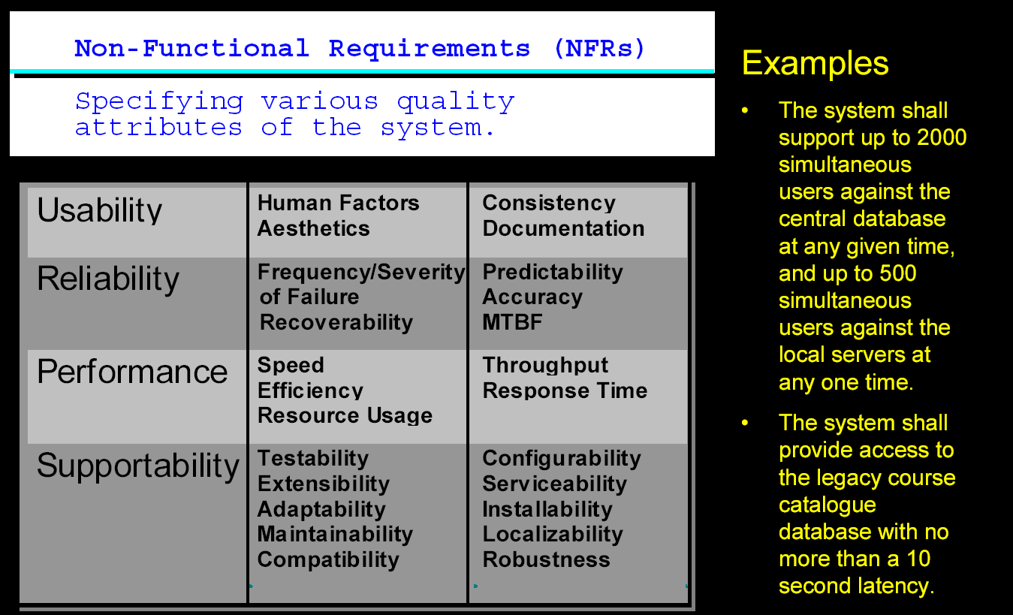
Non-Functional Requirements
(extracted from the slides of Peter Hauker, Rational)

Slide 26
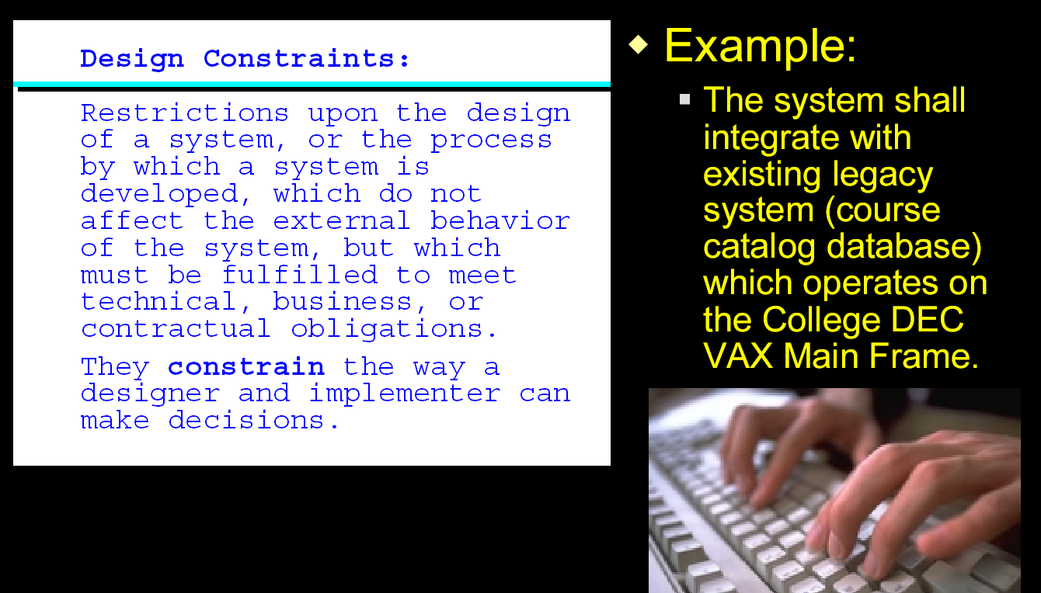
Design Constraints
(extracted from the slides of Peter Hauker, Rational)

Slide 27
More on Requirements v.s. Design
Requirements: WHAT
Design: HOW

Slide 28
Importance of Requirements
The set of requirements constitute a contract between the client and the software developer
  It should be written such that all stakeholders can understand what the system will do.
  It allows developer to map problem domain concepts to solution domain concepts

Slide 29
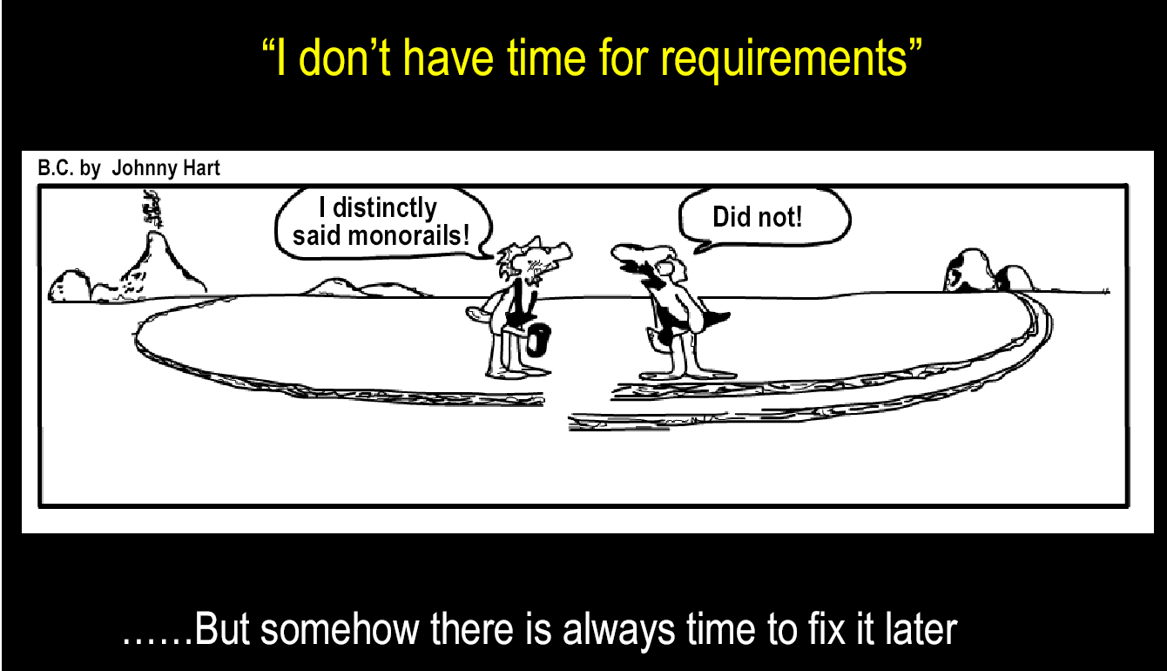
Importance of Requirements
(extracted from the slides of Peter Hauker, Rational)

Slide 30
High Cost of Requirements Errors
Errors made at the requirements stage are very expensive to fix later.
You might well implement the stated requirements correctly, but it won’t be the system the customer really wants.
Basic goal: determine and establish the precise expectations of the customer about the proposed software system.

Slide 31
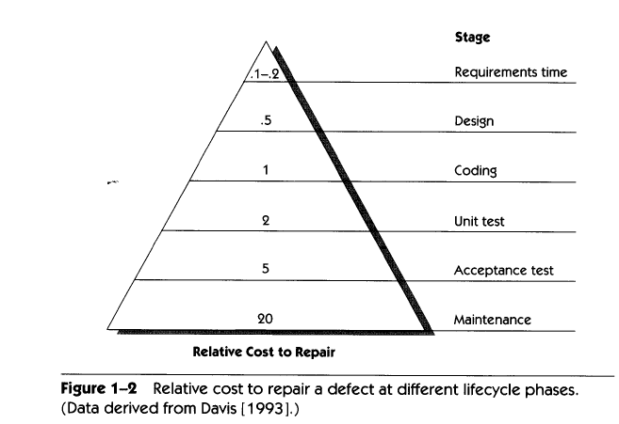
High Cost of Requirements Errors

Slide 32
How Do We … ?
… know what the system is supposed to do?
… keep track of the current status of requirements?
… determine the impact of a requirements change?
  By proper requirements management

Slide 33
Agenda for this Lecture
What are Requirements?
  Definition
  Levels and types of rqmts
  Their Importance
Role of Stakeholders
Introduction to Requirements Engineering
  Development
  Management
  Standards
Tools for RM
Discussion

Slide 34
Stakeholders in SE
Customers
  Those who pay for the software
Users
  Those who use the software
Software developers
Development Managers
Problem: The customer often doesn’t have good grasp of what he wants.

Slide 35
Agenda for this Lecture
What are Requirements?
  Definition
  Levels and types of rqmts
  Their Importance
Role of Stakeholders
Introduction to Requirements Engineering
  Development
  Management
  Standards
Tools for RM
Discussion

Slide 36
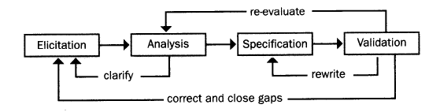
Requirements Development Process
Notes:
Elicitation: work with the customer on gathering requirements
Analysis: process this information to understand it, classify in various categories, and relate the customer needs to possible software requirements
Specification: Structure the customer input and derived requirements as written documents and diagrams
Validation: you’ll ask your customer to confirm that what you’ve written is accurate and complete and to correct errors.
This iterative process continues throughout requirements development
No single formulaic approach to requirements development.

Slide 37
Requirements Development Process
Elicitation: work with the customer on gathering requirements
Analysis: process this information to understand it, classify in various categories, and relate the customer needs to possible software requirements
Specification: Structure the customer input and derived requirements as written documents and diagrams
Validation: you’ll ask your customer to confirm that what you’ve written is accurate and complete and to correct errors.
Software Requirements Analysis: Introduction

Slide 38
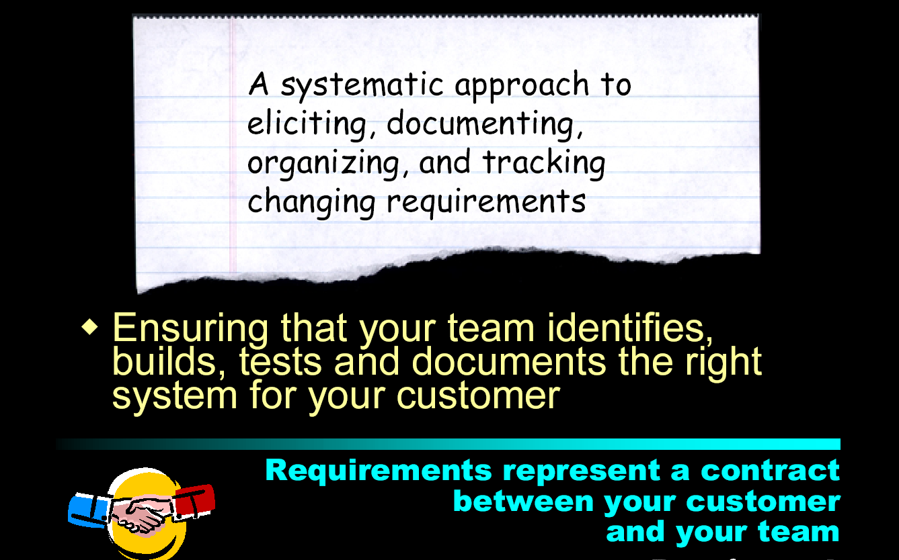
What is Requirements Management?
(extracted from the slides of Peter Hauker, Rational)

Slide 39
Requirements Management in Standards
ISO 900:2000 and SEI-CMM
  Focus on using an effective requirements management process to control and improve the quality of a product or process
  Doesn’t tell you specifically how to actually do requirements management
Comprehensive RM approach:
Notes:
Focus on using an effective requirements management process to control and improve the quality of a product or process

Slide 40
Software Process Assessment: Capability Maturity Model Integration (CMMI)
Process Meta-Model
  a comprehensive set of activities and actions for building software
Grading: Five Maturity Levels and their relationship with the process areas
Developed by the US Software Engineering Institute (SEI), March 2002
Reference: http://www. cmmiinstitute.com/

Slide 41
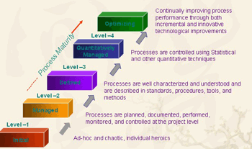
Capability Maturity Model (CMM)

Slide 42
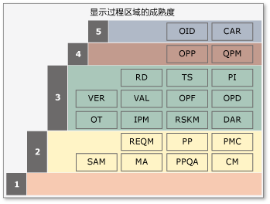

Software Process Assessment: Capability Maturity Model Integration (CMMI)
Notes:
CAR原因分析及解决方案CM配置管理DAR决策分析及解决方法IPM集成管理项目MA度量与分析OID组织创新与部署OPD组织过程定义OPF组织过程焦点OPP组织过程性能OT组织培训PI产品集成PMC项目监督与控制PP项目计划PPQA过程与产品质量保证QPM量化项目管理RD要求定义REQM要求管理RSKM风险管理SAM供应商协议管理TS技术解决方案VER确认VAL验证

Slide 43
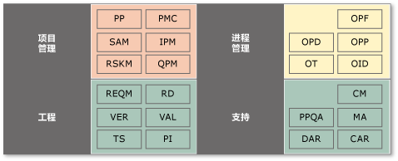
Software Process Assessment: Capability Maturity Model Integration (CMMI)
Notes:
CAR原因分析及解决方案CM配置管理DAR决策分析及解决方法IPM集成管理项目MA度量与分析OID组织创新与部署OPD组织过程定义OPF组织过程焦点OPP组织过程性能OT组织培训PI产品集成PMC项目监督与控制PP项目计划PPQA过程与产品质量保证QPM量化项目管理RD要求定义REQM要求管理RSKM风险管理SAM供应商协议管理TS技术解决方案VER确认VAL验证

Slide 44
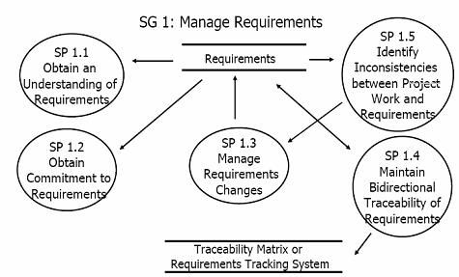
Software Process Assessment: Capability Maturity Model Integration (CMMI)

Slide 45
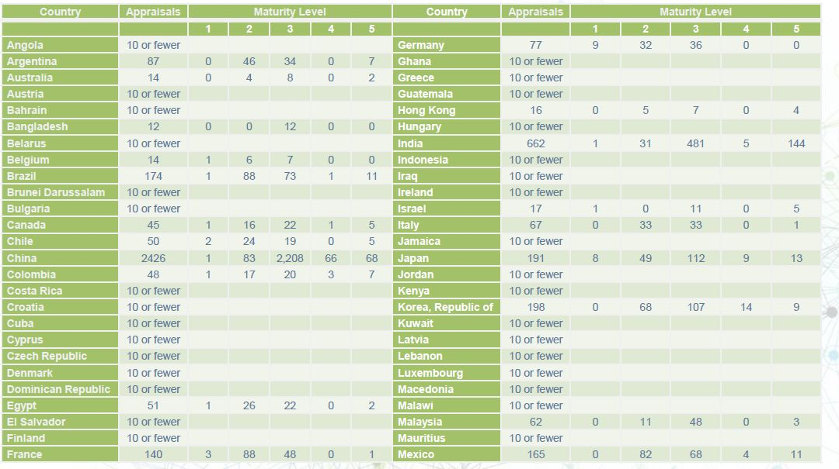
Software Process Assessment: Capability Maturity Model Integration (CMMI)
Software Requirements Analysis: Introduction

Slide 46
Requirements Specification Standard
IEEE 830-1998 IEEE recommended practice for software requirements specifications
Notes:
Focus on using an effective requirements management process to control and improve the quality of a product or process

Slide 47
Agenda for this Lecture
What are Requirements?
  Definition
  Levels and types of rqmts
  Their Importance
Role of Stakeholders
Introduction to Requirements Engineering
  Development
  Management
  Standards
Tools for RM
Discussion

Slide 48
Tools support for RE process
Support for requirements engineering is limited because of the informality and the variability of the process
Modeling tools support the development of system models which can be used to specify the system and the checking of these models for completeness and consistency
Management tools help manage a database of requirements and support the management of changes to these requirements

Slide 49
Evolution of requirements tools
More than three decades ago
  Pencil and paper
  Time consuming :little opportunity to explore alternatives or perform analysis
During the 1980’s
  Word processors, spreadsheets, databases and graphics packages
  Vast improvement, but still paced limitations
Recent RM tools
  Capturing, managing and producing requirement specifications

Slide 50
Classification of requirements tools
General purpose document tools
  MS Office, Open Office, Lotus SmartSuite, etc.
Collaborative tools
  Wikis, online chat, Google Docs, etc.
Requirements managment tools
  Dedicated tools such as Doors, CaliberRM, RequisitePro, etc.
Other tools
  Prototyping tools for web software development: Axure RP,
  ProtoShare, etc.

Slide 51
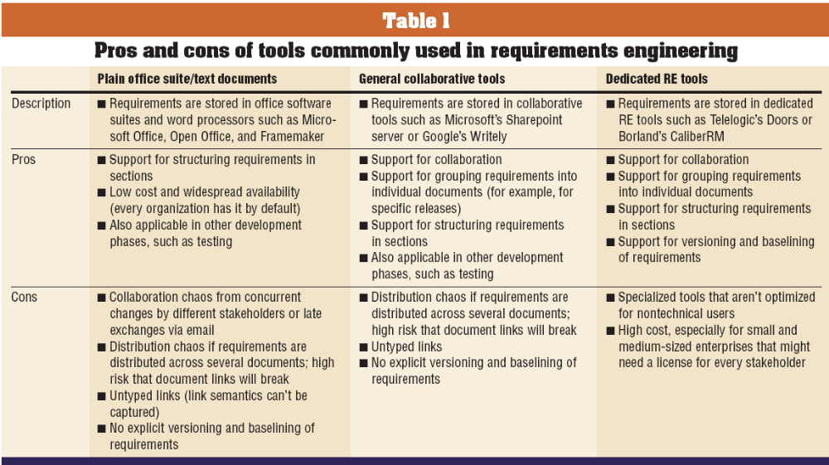
Classification of requirements tools (Cont.)
(decker, et al 2007) http://www.computer.org/portal/cms_docs_software/software/content/promo/s2028_07.pdf

Slide 52
Limitations of document-based approach
difficult to keep the documents current and synchronized
Communicating changes to all affected team members
is a manual process
Difficult to store supplementary information (attributes)
about each requirement
hard to define and maintain links between functional
requirements and other system elements
Tracking requirements status is cumbersome
Difficult for multiple project participants to modify the
requirements, particularly if the participants are
geographically separated

Slide 53
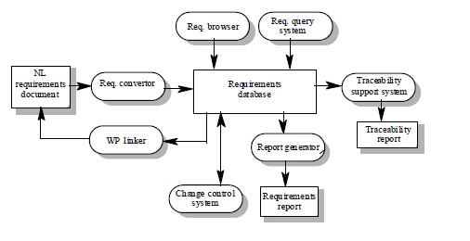
A requirements management system: editing, browsing, querying, reporting and change management

Slide 54
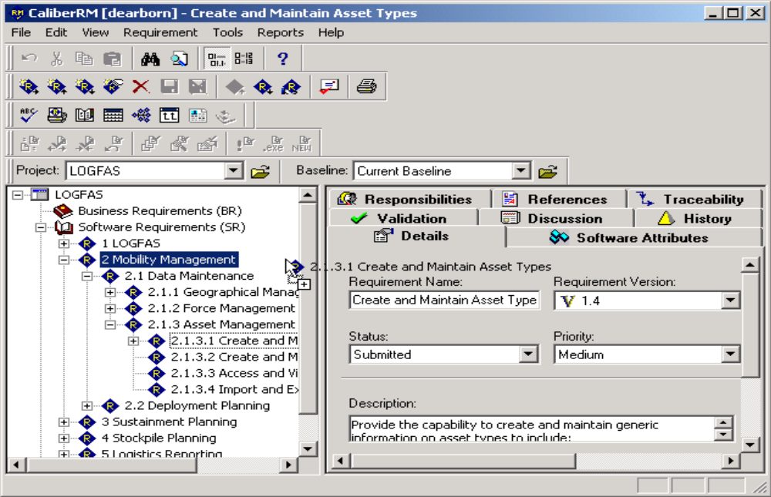
Some dedicated tools

Slide 55
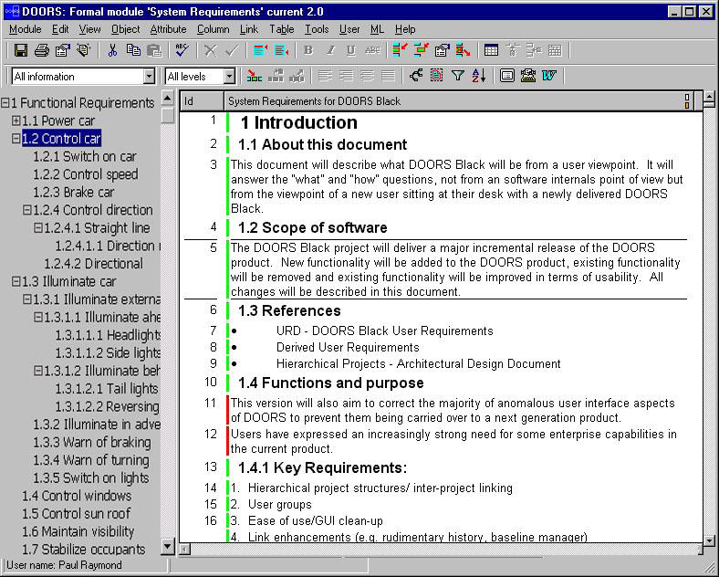
Some dedicated tools(Cont.)

Slide 56
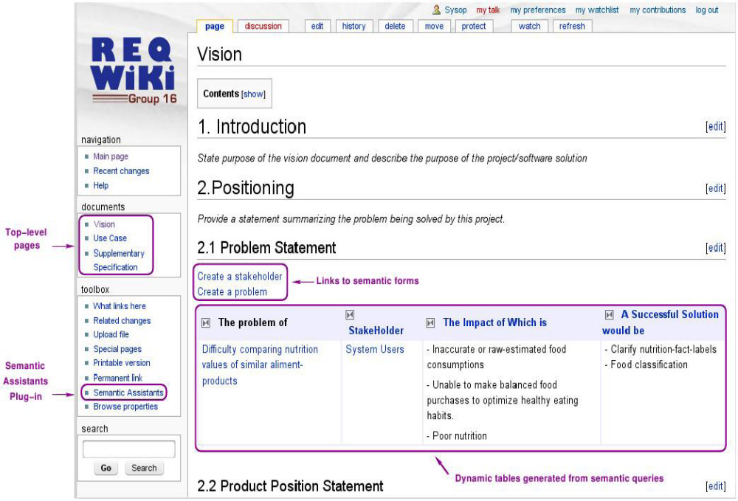
Wiki-based requirements development platforms

Slide 57
Requirements management tools
Requirements tools INCOSE requirements management tool survey:
http://www.incose.org/ProductsPubs/products/rmsurvey.aspx
What else?
Software Requirements Analysis: Introduction

Slide 58
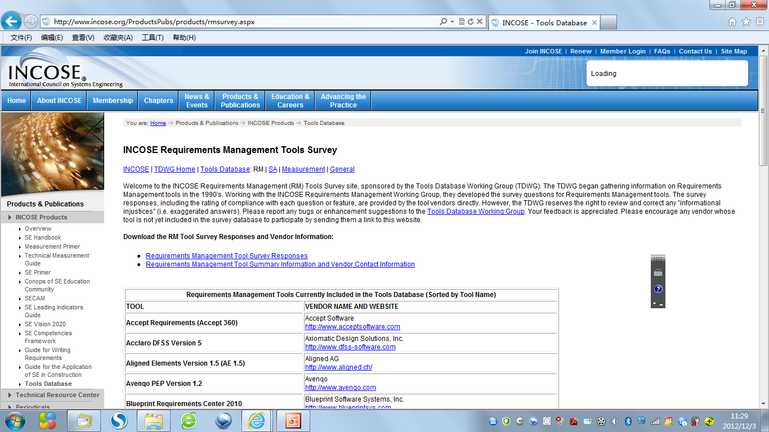
Requirements management tools

Slide 59
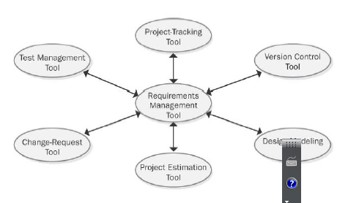
RMTs integrate with other kind of software tools

Slide 60
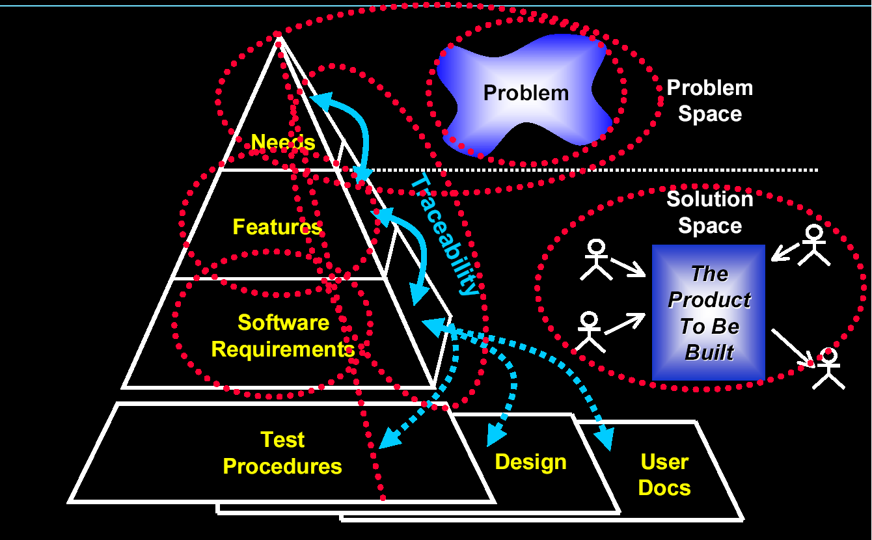
Requirements management: Overview
(extracted from the slides of Peter Hauker, Rational)
Software Requirements Analysis: Introduction

Slide 61
Leffingwell & Widrig Agree …
Think SE, Think BIG!
  Software projects to be tackled will be with ever increasing complexity.
  Requirements management will inevitably be tackled by a multidisciplinary team
    Customer, Product Line Management (PLM), Marketing, …
    Developers, Systems Engineers, Testers, Technical Writers, …

Slide 62
The Software Team
Effective Requirements management can be accomplished only by effective software team
The team must work as a team to address Requirements management Challenge.

Slide 63
Agenda for this Lecture
What are Requirements?
  Definition
  Levels and types of rqmts
  Their Importance
Role of Stakeholders
Introduction to Requirements Engineering
  Development
  Management
  Standards
Tools for RM
Discussion

Slide 64
Discussion
Discuss the project

Slide 65
Review of Today’s Lecture
Requirements Management: …?
Phases of the Requirements Development Process: …?
Role of Stakeholders in Requirements Management…?
3 types of Requirements: …?
Role of the Team in Requirements Development …?

Slide 66
Next?
Eliciting requirements

